Slide 1
Hyper Ledger Fabric
The Business Blockchain

Slide 2
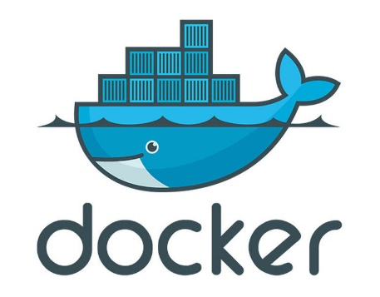
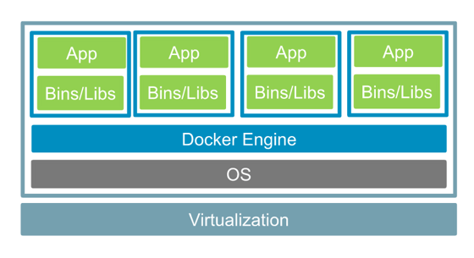
Docker
What is Docker
Docker is a tool designed to make it easier to create, deploy, and run applications by using containers. Containers allow a developer to package up an application with all of the parts it needs, such as libraries and other dependencies, and ship it all out as one package. By doing so, thanks to the container, the developer can rest assured that the application will run on any other Linux machine regardless of any customized settings that machine might have that could differ from the machine used for writing and testing the code.
Docker Architecture
Cannot install different OS
Resource Allocation control
Start up is extremely fast
N+1 Image are shared among containers
Containers implement there own network interfaces
Containers have root access to base os
Data in container or not persistent
Container are built for stateless application

Slide 3
Install Docker on Ubuntu
install CPG Key
curl -fsSL https://download.docker.com/linux/ubuntu/gpg | sudo apt-key add –
Add the Docker repository to APT sources:
sudo add-apt-repository "deb [arch=amd64] https://download.docker.com/linux/ubuntu $(lsb_release -cs) stable"
update Ubuntu
sudo apt-get upgrade
sudo apt-get update
check repo
apt-cache policy docker-ce
install Docker
sudo apt-get install -y docker-ce
check Docker version
docker -v
install Docker Composer (on Ubuntu it is not automatically installed with Docker)
check latest version (1.19)
Install
curl -L https://github.com/docker/compose/releases/download/1.19.0/docker-compose-`uname -s`-`uname -m` -o /usr/local/bin/docker-compose
set permission
sudo chmod +x /usr/local/bin/docker-compose
check version
docker-compose --version

Slide 4

Go Lang Setup on Ubuntu
check go website for latest version (1.10)
Download
curl -O https://storage.googleapis.com/golang/go1.10.linux-amd64.tar.gz
Untar
tar xvf go1.10.linux-amd64.tar.g
change go user to root:root
sudo chown -R root:root ./go
move directory
sudo mv go /usr/local
set go path
pico ~/.profile
add this to the bottom of the file
export GOPATH=$HOME/work
export PATH=$PATH:/usr/local/go/bin:$GOPATH/bin
Save and exit file
refresh profile
source ~/.profile
Check Version
go version

Slide 5
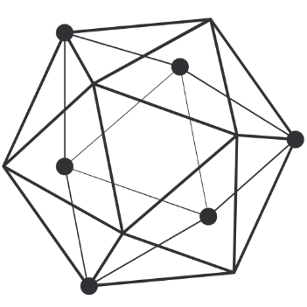
Hyperledger Fabric :: Shell Script
#!/bin/bash
#
# Copyright IBM Corp. All Rights Reserved.
#
# SPDX-License-Identifier: Apache-2.0
#
# current version of fabric released
export VERSION=${1:-1.0.6}
# current version of fabric-ca released
export CA_VERSION=${2:-$VERSION}
export ARCH=$(echo "$(uname -s|tr '[:upper:]' '[:lower:]'|sed 's/mingw64_nt.*/windows/')-$(uname -m | sed 's/x86_64/amd64/g')" | awk '{print tolower($0)}')
#Set MARCH variable i.e ppc64le,s390x,x86_64,i386
MARCH=`uname -m`
dockerFabricPull() {
local FABRIC_TAG=$1
for IMAGES in peer orderer couchdb ccenv javaenv kafka zookeeper tools; do
echo "==> FABRIC IMAGE: $IMAGES"
echo
docker pull hyperledger/fabric-$IMAGES:$FABRIC_TAG
docker tag hyperledger/fabric-$IMAGES:$FABRIC_TAG hyperledger/fabric-$IMAGES
done
}

Slide 6
Hyperledger Fabric :: Shell Script
dockerCaPull() {
local CA_TAG=$1
echo "==> FABRIC CA IMAGE"
echo
docker pull hyperledger/fabric-ca:$CA_TAG
docker tag hyperledger/fabric-ca:$CA_TAG hyperledger/fabric-ca
}
: ${CA_TAG:="$MARCH-$CA_VERSION"}
: ${FABRIC_TAG:="$MARCH-$VERSION"}
echo "===> Downloading platform binaries"
curl https://nexus.hyperledger.org/content/repositories/releases/org/hyperledger/fabric/hyperledger-fabric/${ARCH}-${VERSION}/hyperledger-fabric-${ARCH}-${VERSION}.tar.gz | tar xz
echo "===> Pulling fabric Images"
dockerFabricPull ${FABRIC_TAG}
echo "===> Pulling fabric ca Image"
dockerCaPull ${CA_TAG}
echo
echo "===> List out hyperledger docker images"
docker images | grep hyperledger*

Slide 7
Hyperledger Fabric :: Shell Script
hyperledger-fabric
curl -sSL https://goo.gl/kFFqh5 | bash -s 1.0.6
===> List out hyperledger docker images
hyperledger/fabric-couchdb x86_64-1.0.6 380446aa57b6 2 weeks ago 1.5GB
hyperledger/fabric-kafka x86_64-1.0.6 4e726a9527ec 2 weeks ago 1.29GB
hyperledger/fabric-zookeeper x86_64-1.0.6 205a873eee5d 2 weeks ago 1.32GB
hyperledger/fabric-tools x86_64-1.0.6 322eaa2b8786 2 weeks ago 1.33GB
hyperledger/fabric-orderer x86_64-1.0.6 659d92c1be85 2 weeks ago 151MB
hyperledger/fabric-peer x86_64-1.0.6 28c7c07db540 2 weeks ago 154MB
hyperledger/fabric-javaenv x86_64-1.0.6 b39e5e521f2a 2 weeks ago 1.41GB
hyperledger/fabric-ca x86_64-1.0.6 fe3c9b6542cf 2 weeks ago 238MB
hyperledger/fabric-ccenv x86_64-1.0.6 2e695012bcff 2 weeks ago 1.28GB
set path
-set the hyperledger fabric bin directory to path
export PATH=/home/hyperledger/fabric/bin:$PATH
setup hyperledger fabric
- generate the required files
./byfn.sh -m generate
-- will create the following information
- channel-artifacts [ folder]
- crypto-config [Folder ]
- docker-compose-e2e.yaml [ Files]

Slide 8
Hyperledger Fabric :: Custom Setup Membership Service Providers( MSP)
Note:
Membership Service Provider (MSP) is a component that aims to offer an abstraction of a membership operation architecture.
MSP name and MSP ID needs to specified in order to reference the MSP in the Network and the MSP ID has to be unique across the instance
Cypto-config.yaml file notes:
Orderers [OrdererOrgs]
have multiply order as it will become a single point of failure (min 3)
Config:
Name
The name of the organization
Keep it simple and try not to use special characters try to keep it to standard ANSII
Domain
use FQDN
does not have to be TLD
only visible internally
Specs
used to configure multiple orderers
Peers [PeerOrg]
the peers section is very similar to the orderers it has a few other paramters
Config
Template
use to create peers
do not have one peer have at least 3
User
used to create users
might be useful if you have predefined users
most of the time in production you will use your orgainization auth server like LDAP

Slide 9
Hyperledger Fabric :: Custom Setup Membership Service Providers( MSP)
SAMPLE:
OrdererOrgs:
- Name: OrdererNodeDynamic
Domain: nodedynamics.com
Specs:
- Hostname: orderer1
- Hostname: orderer2
PeerOrgs:
- Name: NodeDynamics
Domain: hl0.nodedynamics.com
Template:
Count: 3
Users:
Count: 1
HOW TO EXECUTE:
cryptogen generate --config=./<name of file>.yaml
KEY POINT:
the Keystore cert cannot be regenerated so keep it safe
will check it on the bit level for cert

Slide 10
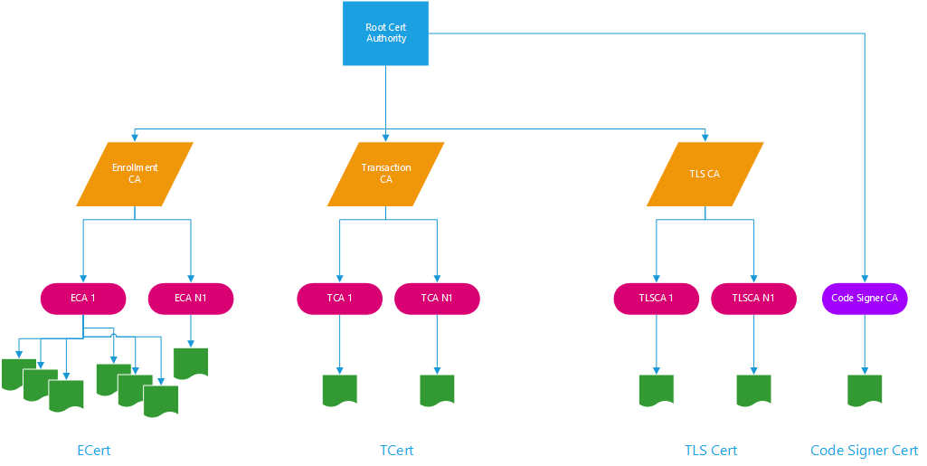
Hyperledger Fabric :: Custom Setup Membership Service Providers( MSP)
Cert Structure

Slide 11
Hyperledger Fabric :: Custom Setup Configuration Transaction Generator
the configtxgen tool is used to create four configuration artifacts
orderer genesis block
channel configuration transactions
two anchor peer transactions - one for each Peer Org
Genesis
genesis is the first block of the block chain
contains all the public keys of all the entities of the network
to alter the genesis file it need to go through the entire process of the blockchain and it will be written to the block, this is very import to as there is a traceability
configtx.yaml
Organizations: Note: this is used to list all the organization in the network
Name: [ this is the name of the organization and it is a require field]
ID: [ is required and has to be unique through the network. this is a short key]
N: [the location of the MSP Direct that was generate during the cypto operation]
AnchorPeer: [ User to talk to other peers in different network using the gossip protocol. This is not the required]
Host: [ FQDN of the anchor peer ]
Port: [ the gossip protocol usually uses port number 7051]
Orderer [ this section define the order services underling mechanism]
OrdererType : [solo use in dev, Kafka in prod]
Addresses : [ the <FQDN:Port> of the orders. you could have multiply point for fault tolerance]
BatchTimeout : [ the amount of time use before creating a new block
BatchSize :[ this is used to control the number of message in the block, this is very important for performance tuning and sync ]
Kafka : [ this is used to configuring kafka brokers]
Organizations : [ this is for advance feature and will not go into detail ]
Application : [ this is for advance feature and will not go into detail ]

Slide 12
Hyperledger Fabric :: Custom Setup Configuration Transaction Generator
Profiles: [ this profile is used to give highlevel configuration and it is used as a paramter when generation the artifacts], [ you could have unlimited profiles i am going to only configure two for now as an example]
GenesisBlock:
Orderer: [could use *<name of order> to point to given order in the current file], [in yaml & is used as a alias]
Organizations: [ could use *<node of orgainization> to alias]
Consortium: [the group of orginization that you want to serve]
<name of the consortium>:
Organizations: [ give list of org that you want to part of the Consortium]
ChannelProfile:
ChannelProfile:
Application [cover in advance course]
Organizations[ this are the org that are used to be part of the channel]
GENERATE ARTIFACT
Genesis Block:
configtxgen -profile <profile name> -outputBlock <location of the where the file will be stored>
example: configtxgen -profile GenesisBlock -outputBlock ./channel-artifacts/genesis.block [ this will create the gensis block],[ TIP: you have to name it genesis.block or it will fail]
Channel:
configtxgen -profile <profile name> -outputCreateChannelTx <location of the where the file will be stored> -channelID <Channel Name> [ the channel ID is important as it is used to execute everything]
example: configtxgen -profile ChannelProfile -outputCreateChannelTx ./channel-artifacts/channel.tx -channelID testchannel
AnchorPeers:
configtxgen -profile <profile name> -outputAnchorPeersUpdate <location of the where the file will be stored> -channelID <Channel Name> -asOrg <org name specified in the config>
example: configtxgen -profile ChannelProfile -outputAnchorPeersUpdate ./channel-artifacts/Org1MSPanchors.tx -channelID testchannel -asOrg Org1MSP
Notes: [ this will produce a serialize proto buffer structure]

Slide 13
Hyperledger Fabric :: Custom Setup Configuration Transaction Generator
SAMPLE:
Profiles:
GenesisBlock:
Orderer:
<<: *OrdererDefault
Organizations
*OrdererOrg
Consortiums:
DefaultConsortium:
DefaultConsortium:
*nodedynamics
ChannelProfile:
Consortium: DefaultConsortium
Application:
<<: *ApplicationDefault
Organizations:
*nodedynamics
Organizations:
&OrdererOrg
Name: OrdererOrg
ID: OrderOrg
MSPDir: crypto-config/ordererOrganizations/nodedynamics.com/msp
&nodedynamics
Name: NodeDynamics
ID: ndOrg1
MSPDir: crypto-config/peerOrganizations/hl0.nodedynamics.com/msp
AnchorPeers:
Host: peer0.hl0.nodedynamics.com
Port: 7051

Slide 14
Hyperledger Fabric :: Custom Setup Configuration Transaction Generator
Orderer: &OrdererDefault
OrdererType: solo
Address:
orderer.nodedynamics.com:7050
BatchTimeout: 2s
BatchSize:
MaxMessageCount: 10
AbsoluteMaxBytes: 99 MB
PreferredMaxBytes: 512 KB
Organizations
Application: &ApplicationDefault
Organizations:

Slide 15
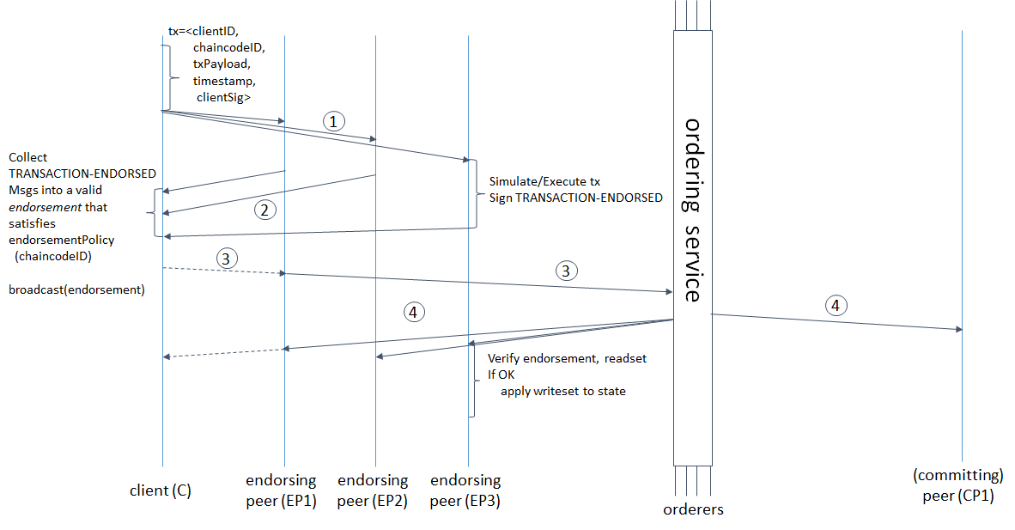
Hyperledger Fabric :: Message Flow

Slide 16
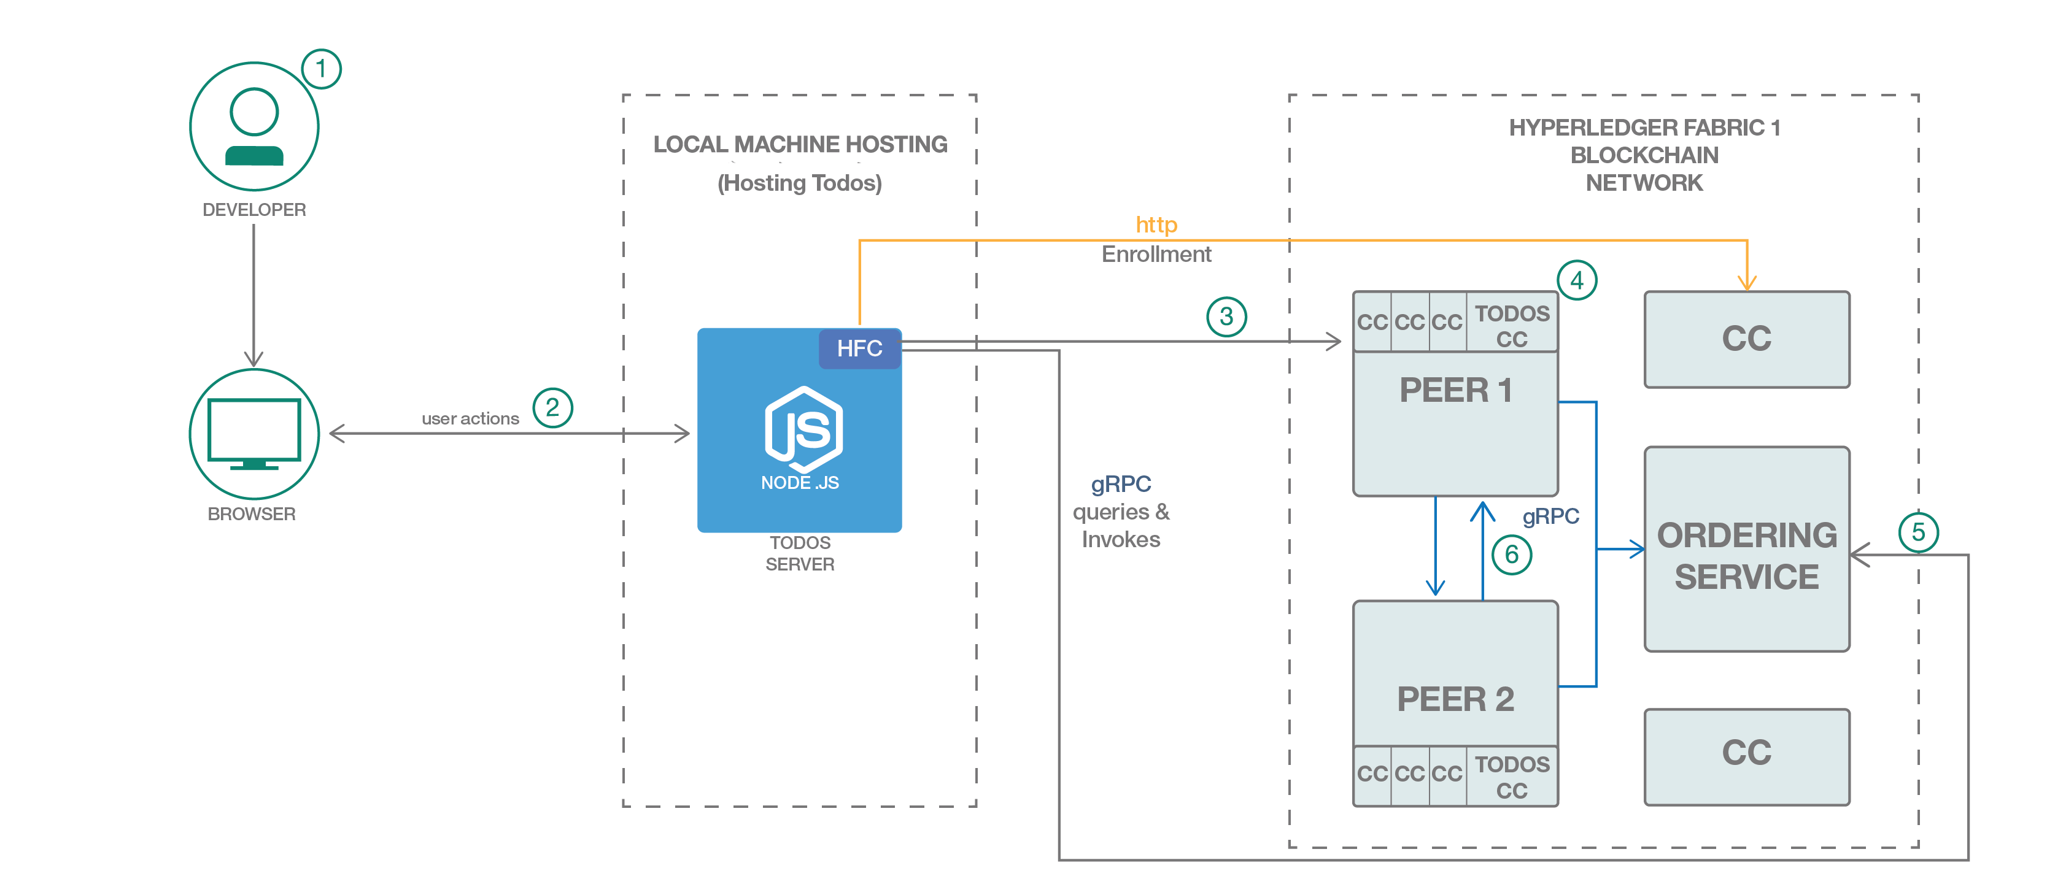
Hyperledger Fabric :: GRPC

Slide 17

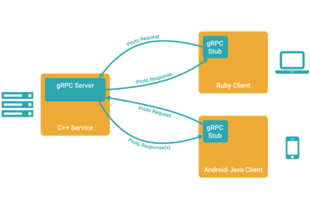
Hyperledger Fabric :: GRPC
What is GRPC
gRPC is a RPC platform developed by Google which was announced and made open source in late Feb 2015. The letters “gRPC” are a recursive acronym which means, gRPC Remote Procedure Call.
gRPC has two parts, the gRPC protocol, and the data serialization. By default gRPC utilizes Protobuf for serialization, but it is pluggable with any form of serialization you wish to use, with some caveats, which I will get to later.
GRPC is a binary protocol
Bidirectional Http 2.0
Protobuf create .proto file that support data type
marshalling and un marshalling is extremely fast with little overhead
http://yura415.github.io/js-protobuf-encode-decode/
Has validation and extensibility
Language interoperability

Slide 18
Hyperledger Fabric SDK
Java SDK

Slide 19

Hyperledger Fabric :: Java
Helps facilitate Java applications to manage the lifecycle of Hyperledger Channels and user chaincode
Provides Java APIs to execute transactions, queries and handle chaincode events
Provides Java APIs to connect to Fabric CA (any other CA can be used instead)
Requires User to operate
Assumes the consuming application will manage the persistency of client created artifacts (users, channels, configuration)

Slide 20
Hyperledger Fabric :: Java

Slide 21
Hyperledger Fabric :: Add New Org
Create a new folder for the new org
Mkdir <neworg name>
Create a new crypto. Yaml file
Pico <org>-crypto.yaml
Generate certs
Cryptogen generate –cnfig=./<org>-crypto.yaml
Set the fabric config path and generate channel artifacts
export FABRIC_CFG_PATH=$PWD
Configtxgen -printOrg <orgname MSP > ../channel-artifacts/<orgname>.json
Copy original crypto materials over to the <neworg name> crypto-config folder
cp -r <org foldr>/crypto-config/ordererOrganizations <neworg name>
Update channel
docker exec -it cli bash
Install jq
apt update && apt install jq
start the configtxlator tool
configtxlator start &
Open New window go into container and export url
docker exec -it cli bash
export CONFIGTXLATOR_URL=<new org ip address:7059>
Export ORDERER_CA and the Channel name
export ORDERER_CA=/opt/gopath/src/github.com/hyperledger/fabric/peer/crypto/ordererOrganizations/<org url>/orderers/orderer.<org url>/msp/tlscacerts/tlsca.<org url>-cert.pem
export CHANNEL_NAME=<new channel name>
Get the latest block
peer channel fetch config config_block.pb -o orderer.<org url>:7050 -c $CHANNEL_NAME --tls --cafile $ORDERER_CA
Convert config_block protobuf to json
curl -X POST --data-binary @config_block.pb "$CONFIGTXLATOR_URL/protolator/decode/common.Block" | jq . > config_block.json

Slide 22
Hyperledger Fabric :: Add New Org
isolate the current config specific information
jq .data.data[0].payload.data.config config_block.json > config.json
Append file
jq -s '.[0] * {"channel_group":{"groups":{"Application":{"groups":{“<org name MSP>":.[1]}}}}}' config.json ./channel-artifacts/<org anme>.json >& updated_config.json
update
curl -X POST --data-binary @config.json "$CONFIGTXLATOR_URL/protolator/encode/common.Config" > config.pb
curl -X POST --data-binary @updated_config.json "$CONFIGTXLATOR_URL/protolator/encode/common.Config" > updated_config.pb
Find delta and isolate
curl -X POST -F channel=$CHANNEL_NAME -F "original=@config.pb" -F "updated=@updated_config.pb" "${CONFIGTXLATOR_URL}/configtxlator/compute/update-from-configs" > config_update.pb
Convert config_update.pb back to json
curl -X POST --data-binary @config_update.pb "$CONFIGTXLATOR_URL/protolator/decode/common.ConfigUpdate" | jq . > config_update.json
Add stripped data back
echo '{"payload":{"header":{"channel_header":{"channel_id":"mychannel","type":2}},"data":{"config_update":'$(cat config_update.json)'}}}' | jq . > config_update_in_envelope.json
Convert back to protobuf
curl -X POST --data-binary @config_update_in_envelope.json "$CONFIGTXLATOR_URL/protolator/encode/common.Envelope" > config_update_in_envelope.pb
Sign and add to channel
peer channel signconfigtx -f config_update_in_envelope.pb
Jump to second org and sign it away
export CORE_PEER_MSPCONFIGPATH=/opt/gopath/src/github.com/hyperledger/fabric/peer/crypto/peerOrganizations/org2.example.com/users/Admin\@org2.example.com/msp/ && export CORE_PEER_ADDRESS=peer0.org2.example.com:7051 && export CORE_PEER_LOCALMSPID="Org2MSP" && export CORE_PEER_TLS_ROOTCERT_FILE=/opt/gopath/src/github.com/hyperledger/fabric/peer/crypto/peerOrganizations/org2.example.com/peers/peer0.org2.example.com/tls/ca.crt
peer channel update -f config_update_in_envelope.pb -c $CHANNEL_NAME -o orderer.example.com:7050 --tls true --cafile $ORDERER_CA

Slide 23
Hyperledger Fabric :: Add New Org
Start new org docker
docker-compose -f docker-compose-org3.yaml up
Jump into <new org> docker cli
docker exec -it <new org> bash
Add load to variable again
export ORDERER_CA=/opt/gopath/src/github.com/hyperledger/fabric/peer/crypto/ordererOrganizations/example.com/orderers/orderer.example.com/msp/tlscacerts/tlsca.example.com-cert.pem
export CHANNEL_NAME=<channel name>
Start genesis block
peer channel fetch 0 mychannel.block -o orderer.example.com:7050 -c $CHANNEL_NAME --tls --cafile $ORDERER_CA
Join channel
peer channel join -b mychannel.block
Change cert and Join peer1
export CORE_PEER_TLS_ROOTCERT_FILE=/opt/gopath/src/github.com/hyperledger/fabric/peer/crypto/peerOrganizations/<org url>/peers/peer1.<org url>/tls/ca.crt
export CORE_PEER_ADDRESS=peer1.org3.example.com:7051
peer channel join -b mychannel.block
Back to peer0
export CORE_PEER_TLS_ROOTCERT_FILE=/opt/gopath/src/github.com/hyperledger/fabric/peer/crypto/peerOrganizations/<org url>/peers/peer0.<org url>/tls/ca.crt
export CORE_PEER_ADDRESS=peer0.org3.example.com:7051
At this point you should update the chain code to reflect the joining of the new org

Slide 24
Useful Docker Commands
List all images: docker images
List all containers: docker ps
See logs of a docker container: docker logs <container_name>
Delete all images: docker rmi $(docker images -q)
Delete all containers: docker rm $(docker ps -a -q)
Login in a container: docker exec -it <container_name> bash
Stop all containers: docker stop $(docker ps -aq)

